Slide 1

IMDB Ratings
Group 9:
Davin Chaltu
Ketrine Fernanda
Kenny Li
Vivian Musleh
Yancy Victoriano

Slide 2
Agenda
Project summary
Project analysis
Challenge with the dataset
Project output

Slide 3

Project Summary
During the pandemic, people spent more time than usual at home by streaming movies through several platforms for their entertainment because they cannot go out.
With movie productions increasing and the streaming industry growing, providing movies from many different countries and many different languages makes choosing a good movie more difficult
To ease the process of searching for a good movie, our program allows a user to select a genre to see a list of movies that would best fit their interest. From there, the user can decide what kind of movie they want based on further interests to narrow down the list even further
Attributes such as average vote, rating ,viewer/critic review, movie genre, language, etc. will be the filters allow the program to pinpoint the best movies according to the user's selection of genre.
These filters will generate most accurate and satisfactory recommendation for the user which will resolve the never-ending question of "What should I watch?"

Slide 4
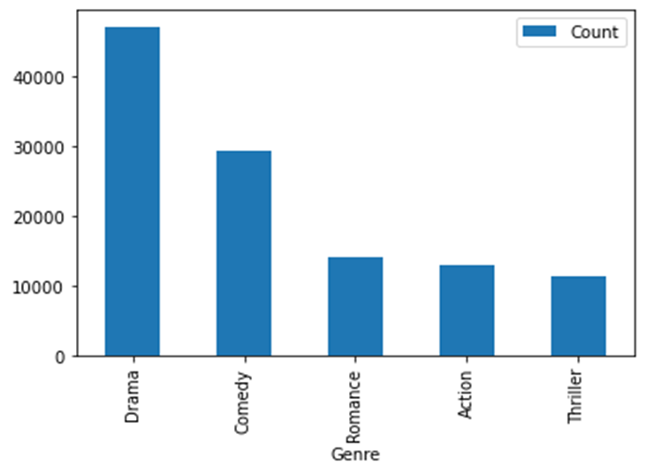
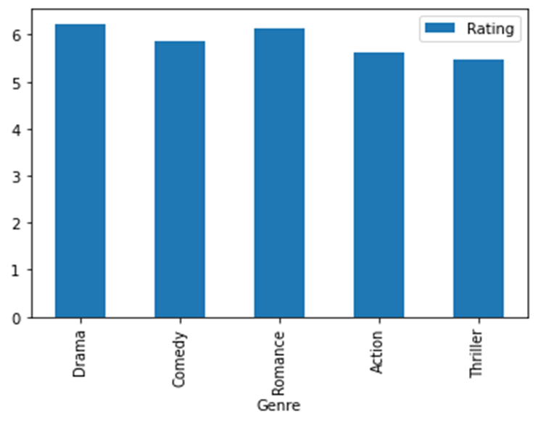
One Factor Searches are too High Level
IMDB Database we used has almost 80 thousand titles. The sheer volume will ensure users will not be able to search and decide between all of them.
Looking by just the Genre is not sufficient. Looking at the average score of the 5 most popular movie genres shows that there is not enough information to distinguish them apart.

Slide 5
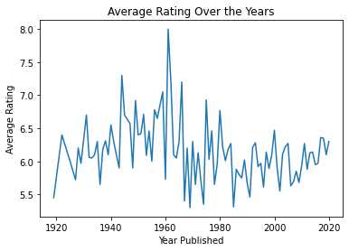
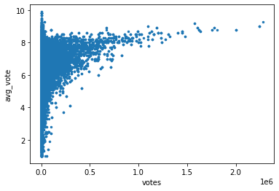
Correlations and Time Series Plot
By providing the user with summarized information of multiple features, it can empower them to explore what movies define their tastes.
We provide a Time-Series Plot that is specific to the Genre of the User's choosing to show when the best movies were released.
We have also created a scatter plots to show the relationship of:
Duration vs Rating
Metascore vs Rating
Vote Count vs Rating

Slide 6
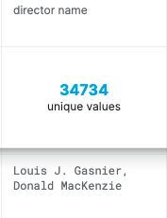
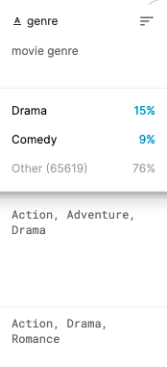
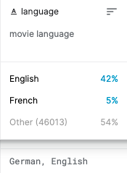
Challenge with the dataset
Large dataset
Multiple value in one column

Slide 7
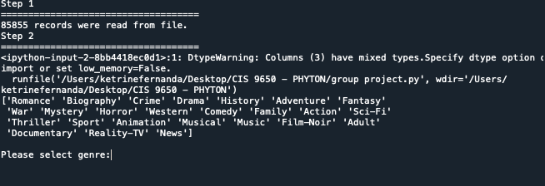
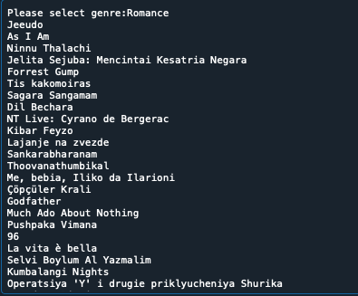
Let user input the genre and the program will list 100 movies based on the genre.

Slide 8
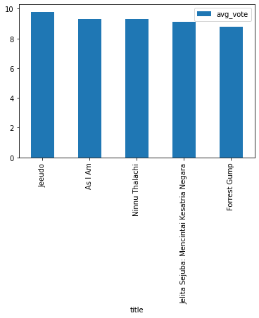
Bar chart for top 5 favorites movies based on the genre

Slide 9
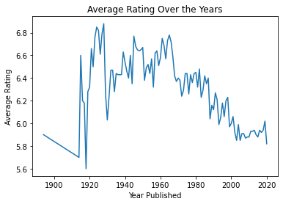
Average Rating Over the years

Slide 10
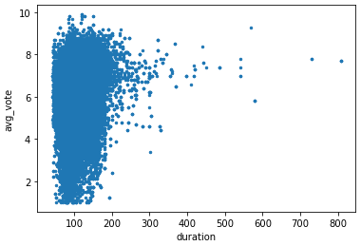

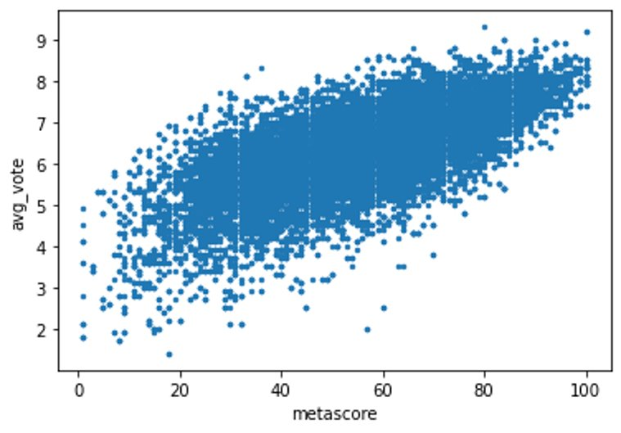
Correlation between metascore and average vote per movie
Correlation between number of votes and average vote per movie
Correlation between duration and average vote per movie

